Slide 1
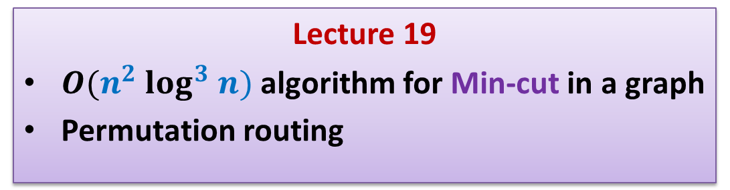
Randomized Algorithms CS648
Lecture 19
$O(n^{2} log^{3} n)$algorithm for Min-cut in a graph
Permutation routing

Slide 2
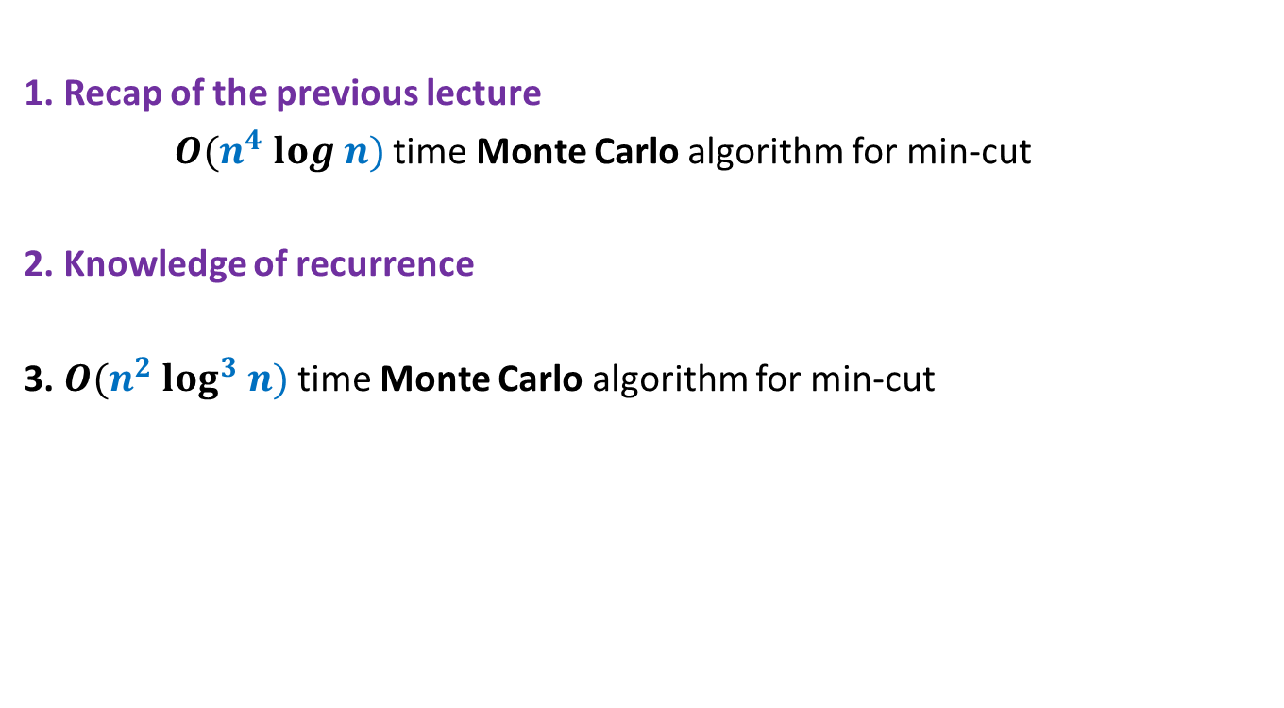
Overview
1. Recap of the previous lecture
$O(n^{4} log n)$time Monte Carlo algorithm for min-cut
2. Knowledge of recurrence
3. $O(n^{2} log^{3} n)$time Monte Carlo algorithm for min-cut
To analyse time complexity of an algorithm
To design efficient algorithm
There are so many lessons that you can learn from today’s lecture… ☺

Slide 3
Recap of the previous lecture
Min-cut

Slide 4



Algorithm for min-cut
Min-cut($G$):
{ Repeat ?? times
{
Let $e∈_{r}G$;
$G$ ← Contract($G,e$).
}
return the edges of multi-graph $G$;
}
Running time: $O(n^{2})$
Success Probability:
$$n−2$$
$$\frac{2}{n(n−1)}$$

Slide 5
Algorithm for min-cut
Min-cut-high-probability($G$):
{ Repeat Min-cut($G$) algorithm $cn^{2}$ log $n$ times
and report the smallest cut computed;
}
Running time: $O(n^{4} log n)$
Error Probability : ${\left(1−\frac{1}{n^{2}}\right)}^{cn^{2}log n}$
< $\frac{1}{n^{c}}$

Slide 6
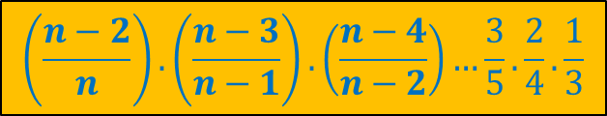
Algorithm for min-cut
Min-cut($G$):
{ Repeat ?? times
{
Let $e∈_{r}G$;
$G$ ← Contract($G,e$).
}
return the edges of multi-graph $G$;
}
Running time: $O(n^{2})$
Success Probability:
$$n−2$$
$$\frac{2}{n(n−1)}$$
$$\left(\frac{n−2}{n}\right).\left(\frac{n−3}{n−1}\right).\left(\frac{n−4}{n−2}\right)…\frac{3}{5}.\frac{2}{4}.\frac{1}{3}$$

Slide 7
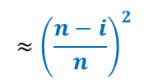
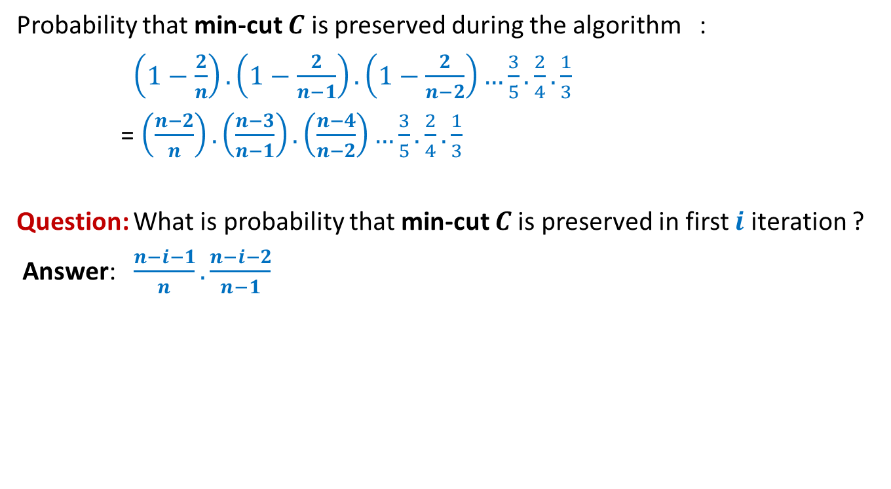
Algorithm for min-cut
Probability that min-cut $C$ is preserved during the algorithm :
$\left(1−\frac{2}{n}\right).\left(1−\frac{2}{n−1}\right).\left(1−\frac{2}{n−2}\right)…\frac{3}{5}.\frac{2}{4}.\frac{1}{3}$
= $\left(\frac{n−2}{n}\right).\left(\frac{n−3}{n−1}\right).\left(\frac{n−4}{n−2}\right)…\frac{3}{5}.\frac{2}{4}.\frac{1}{3}$
Question: What is probability that min-cut $C$is preserved in first $i$ iteration ?
Answer: $\frac{n−i−1}{n}.\frac{n−i−2}{n−1}$
$$≈{\left(\frac{n−i}{n}\right)}^{2}$$

Slide 8


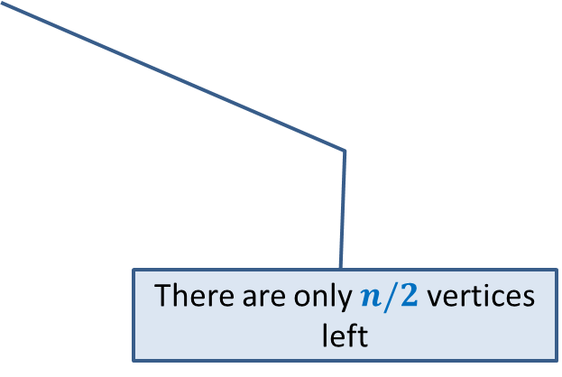
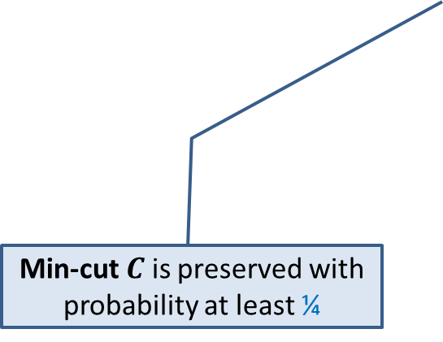
Key observations about Min-Cut algorithm
Algorithm performs $n−2$ contractions :
$$n/2$$
Min-cut $C$ is preserved with probability at least ¼
There are only $n/2$ vertices left

Slide 9

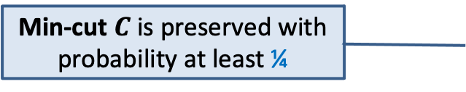








Key observations about Min-Cut algorithm
$$c n$$
$$c (n−1)$$
$$c (n−2)$$
$$n/2$$
…
Min-cut $C$ is preserved with probability at least ¼
$$c\frac{n}{2}$$
$$c\left(\frac{n}{2}−1\right)$$
…
$$c\left(3\right)$$
$$c\left(2\right)$$
$$c\left(1\right)$$

Slide 10


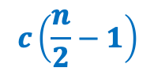








Key observations about Min-Cut algorithm
$$c n$$
$$c (n−1)$$
$$c (n−2)$$
$$n/2$$
…
$$c\frac{n}{2}$$
$$c\left(\frac{n}{2}−1\right)$$
$$n/4$$
$$n/4$$
…
$$c\frac{n}{4}$$
…
$$c\left(3\right)$$
$$c\left(2\right)$$
$$c\left(2\right)$$
$$c\left(1\right)$$
$$c\left(1\right)$$
$C_{1}$
$C_{2}$

Slide 11



Key observations about Min-Cut algorithm
$$c n$$
$$c (n−1)$$
$$c (n−2)$$
$$n/2$$
…
$$c\frac{n}{2}$$
$$c\frac{n}{4}$$
…
$$c\left(2\right)$$
$$c\left(1\right)$$
$C_{1}$
$C_{2}$
$C_{3}$
$C_{4}$

Slide 12


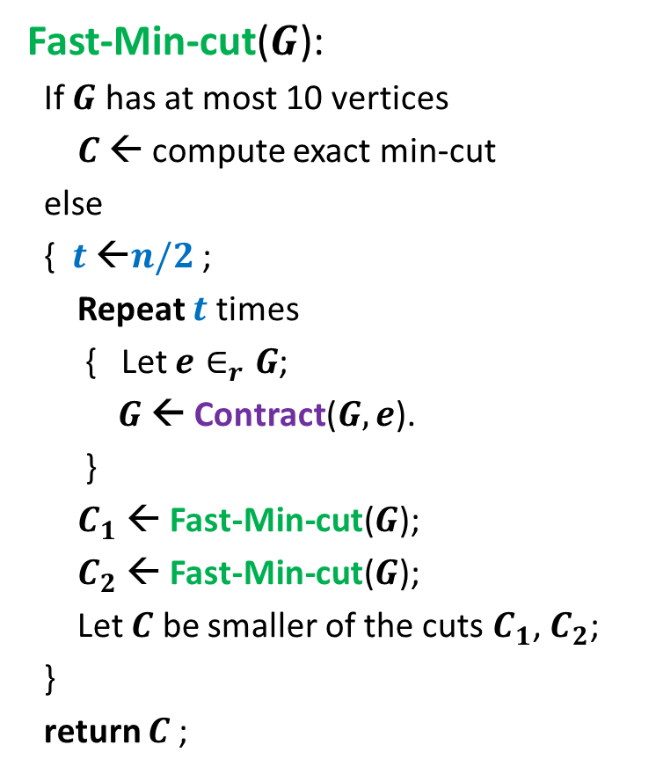


Revised algorithm for min-cut
Time complexity
Fast-Min-cut($G$):
If $G$ has at most 10 vertices
$C$ ← compute exact min-cut
else
{ $t$ ←$n/2$ ;
Repeat $t$ times
{ Let $e∈_{r}G$;
$G$ ← Contract($G,e$).
}
$C_{1}$ ← Fast-Min-cut($G$);
$C_{2}$ ← Fast-Min-cut($G$);
Let $C$ be smaller of the cuts $C_{1}$, $C_{2}$;
}
return $C$;
$T\left(n\right)=1$ for $n≤10$
$T\left(n\right)=cn^{2}+2T\left(n/2\right)$
$$n−t)$$
How to increase this prob. even further ?
reduce $t$.
Prob. the min-cut is preserved till here = ?
1/4

Slide 13
Revisiting Recurrences
In the following slides, we shall revisit common recurrences. Try to solve these recurrences in a simple manner instead of using Master’s theorem. This will help you develop a useful insight into recurrences. This insight will help you fine-tune the previous inefficient algorithm and eventually lead to design (and analysis) of a more efficient algorithm for min-cut.

Slide 14





Common recurrences
$T\left(1\right)=1$
$T\left(n\right)=cn+T\left(n−1\right)$
$T\left(1\right)=1$
$T\left(n\right)=cn+T\left(n/2\right)$
$T\left(1\right)=1$
$T\left(n\right)=cn+2T\left(n/2\right)$
$T\left(1\right)=1$
$T\left(n\right)=cn+2T\left(n/4\right)$
$$O(n^{2})$$
$$O(n)$$
$$O(n log n)$$
$$O(n )$$

Slide 15


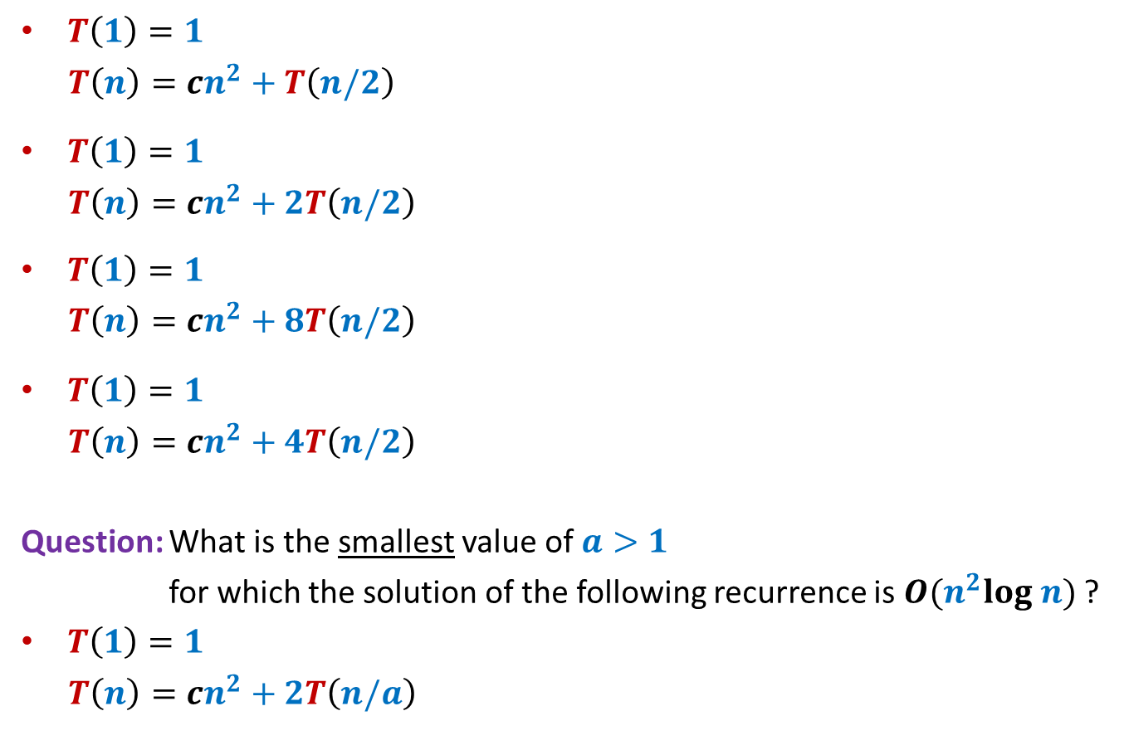



Common recurrences
$T\left(1\right)=1$
$T\left(n\right)=cn^{2}+T\left(n/2\right)$
$T\left(1\right)=1$
$T\left(n\right)=cn^{2}+2T\left(n/2\right)$
$T\left(1\right)=1$
$T\left(n\right)=cn^{2}+8T\left(n/2\right)$
$T\left(1\right)=1$
$T\left(n\right)=cn^{2}+4T\left(n/2\right)$
Question: What is the smallest value of $a>1$
for which the solution of the following recurrence is $O(n^{2}log n)$ ?
$T\left(1\right)=1$
$T\left(n\right)=cn^{2}+2T\left(n/a\right)$
$$O(n^{2})$$
$$O(n^{2})$$
$$O(n^{3})$$
$$O(n^{2} log n)$$
$$a=√2$$
Closer $a$ gets to $1$, the farther $T\left(n\right)$ gets from $n^{2}$

Slide 16
Faster Min-cut algorithm

Slide 17

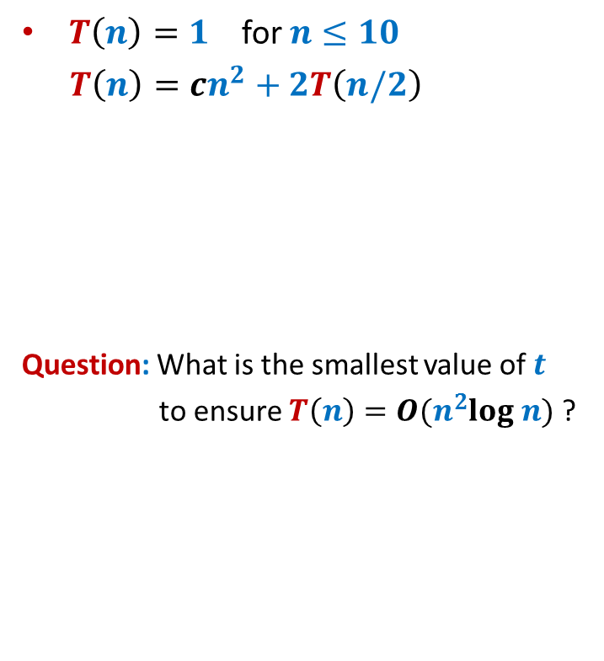

Revised algorithm for min-cut
Time complexity
Fast-Min-cut($G$):
If $G$ has at most 10 vertices
$C$ ← compute exact min-cut
else
{ $t$ ←$n/2$ ;
Repeat $t$ times
{ Let $e∈_{r}G$;
$G$ ← Contract($G,e$).
}
$C_{1}$ ← Fast-Min-cut($G$);
$C_{2}$ ← Fast-Min-cut($G$);
Let $C$ be smaller of the cuts $C_{1}$, $C_{2}$;
}
return $C$;
$T\left(n\right)=1$ for $n≤10$
$T\left(n\right)=cn^{2}+2T\left(n/2\right)$
Question: What is the smallest value of $t$
to ensure $T\left(n\right)=O(n^{2}log n)$ ?
$$n−t)$$
$n−t=$ $n/√2$
➔ $t=$ $n−n/√2$

Slide 18
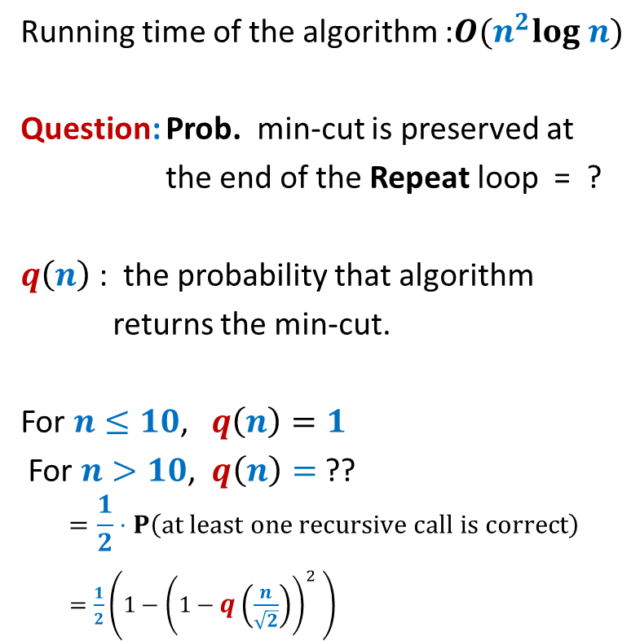
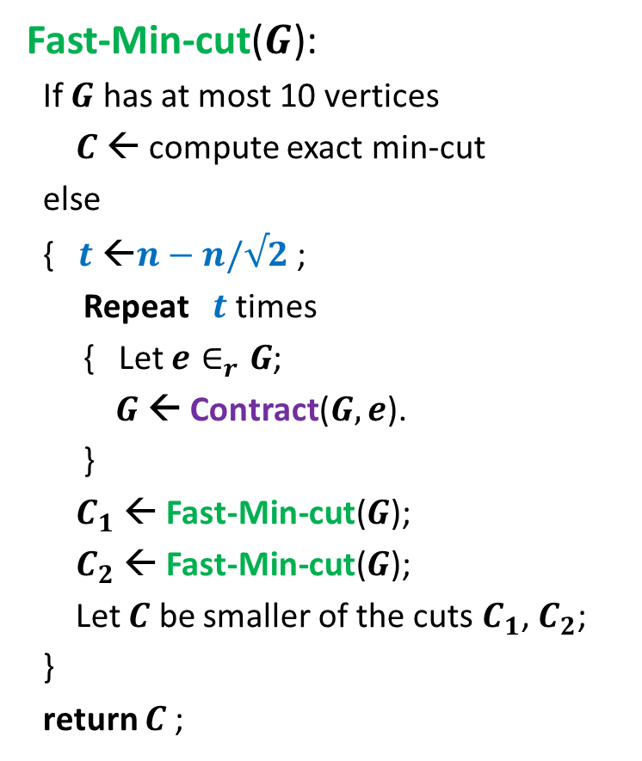

Faster algorithm for min-cut
Fast-Min-cut($G$):
If $G$ has at most 10 vertices
$C$ ← compute exact min-cut
else
{ $t$ ←$n−n/√2$ ;
Repeat $t$ times
{ Let $e∈_{r}G$;
$G$ ← Contract($G,e$).
}
$C_{1}$ ← Fast-Min-cut($G$);
$C_{2}$ ← Fast-Min-cut($G$);
Let $C$ be smaller of the cuts $C_{1}$, $C_{2}$;
}
return $C$;
Running time of the algorithm :$O(n^{2}log n)$
Question: Prob. min-cut is preserved at
the end of the Repeat loop = ?
$q\left(n\right)$ : the probability that algorithm
returns the min-cut.
For $n≤10$, $q\left(n\right)=1$
For $n>10$, $q\left(n\right)=$ ??
$$=\frac{1}{2}⋅P\left(at least one recursive call is correct\right)$$
$=\frac{1}{2}\left(1−{\left(1−q\left(\frac{n}{\sqrt{2}}\right)\right)}^{2} \right)$
1/2

Slide 19
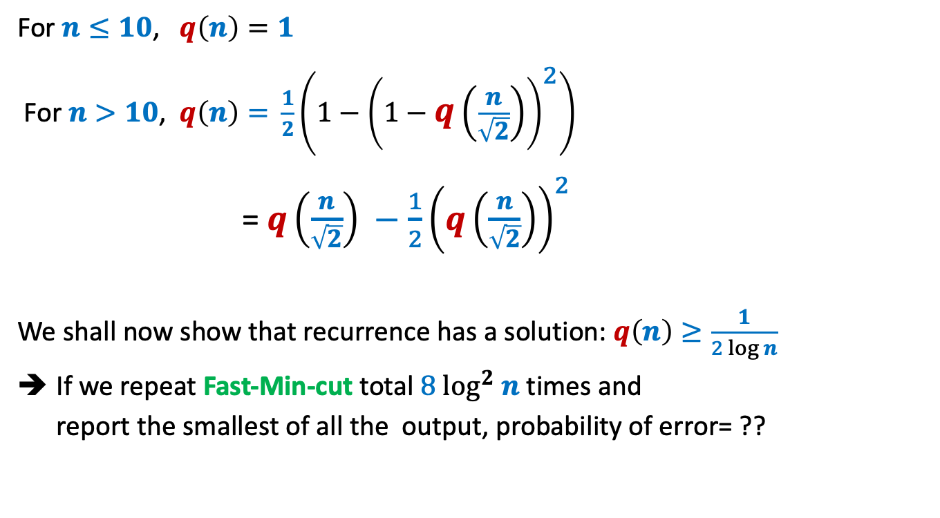
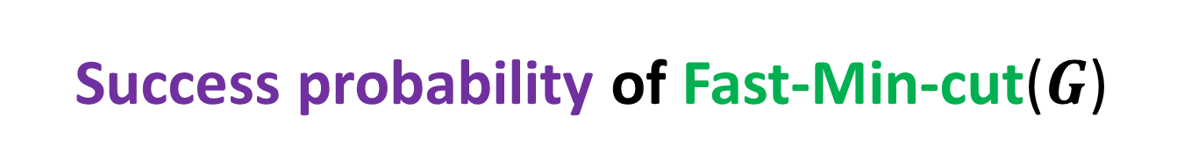


Success probability of Fast-Min-cut($G$)
For $n≤10$, $q\left(n\right)=1$
For $n>10$, $q\left(n\right)=$ $\frac{1}{2}\left(1−{\left(1−q\left(\frac{n}{\sqrt{2}}\right)\right)}^{2}\right)$
= $q\left(\frac{n}{\sqrt{2}}\right) −\frac{1}{2}{\left(q\left(\frac{n}{\sqrt{2}}\right)\right)}^{2}$
We shall now show that recurrence has a solution: $q\left(n\right)≥\frac{1}{2 log n}$
If we repeat Fast-Min-cut total $8 \log^{2} n$ times and
report the smallest of all the output, probability of error= ??
$${\left(1−\frac{1}{2log n}\right)}^{8\log^{2} n}$$
< $n^{−4}$

Slide 20
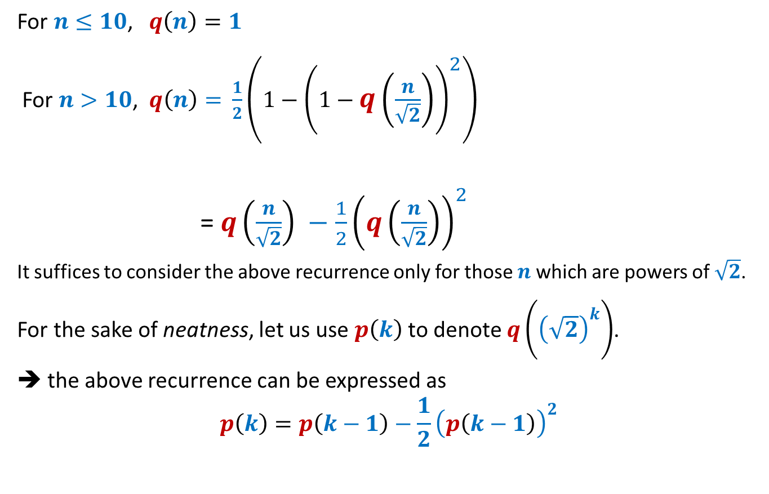
Solving the recurrence
For $n≤10$, $q\left(n\right)=1$
For $n>10$, $q\left(n\right)=$ $\frac{1}{2}\left(1−{\left(1−q\left(\frac{n}{\sqrt{2}}\right)\right)}^{2}\right)$
= $q\left(\frac{n}{\sqrt{2}}\right) −\frac{1}{2}{\left(q\left(\frac{n}{\sqrt{2}}\right)\right)}^{2}$
It suffices to consider the above recurrence only for those $n$which are powers of $\sqrt{2}$.
For the sake of neatness, let us use $p\left(k\right)$to denote $q\left({\left(\sqrt{2}\right)}^{k}\right)$.
➔ the above recurrence can be expressed as
$$p\left(k\right)=p\left(k−1\right)−\frac{1}{2}{\left(p\left(k−1\right)\right)}^{2}$$

Slide 21
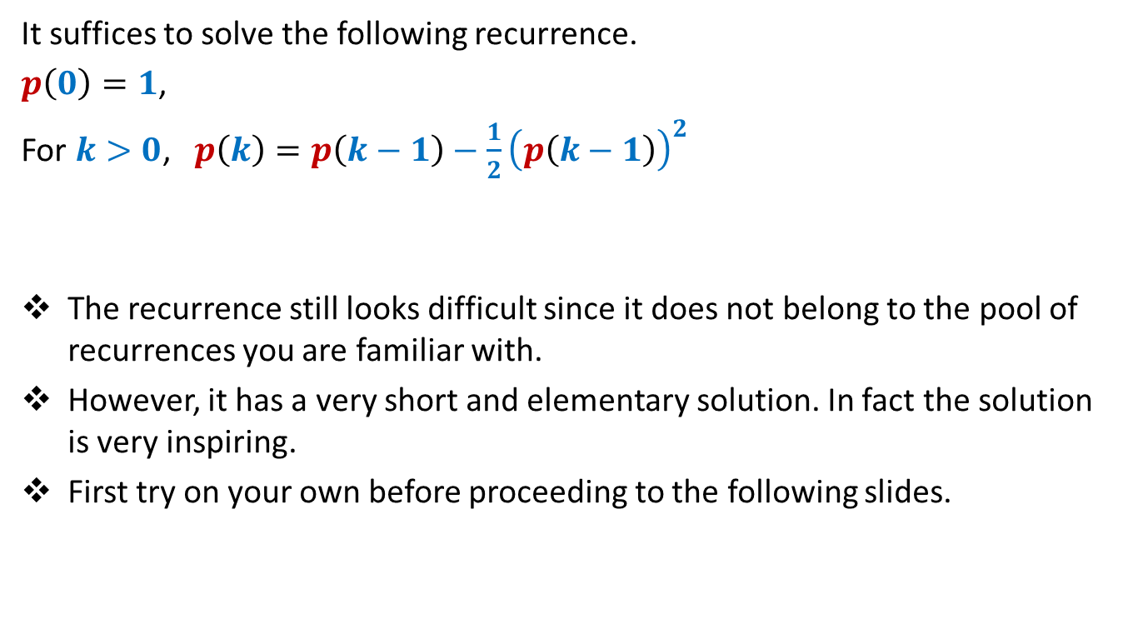
Solving the recurrence
It suffices to solve the following recurrence.
$p\left(0\right)=1$,
For $k>0$, $p\left(k\right)=p\left(k−1\right)−\frac{1}{2}{\left(p\left(k−1\right)\right)}^{2}$
The recurrence still looks difficult since it does not belong to the pool of recurrences you are familiar with.
However, it has a very short and elementary solution. In fact the solution is very inspiring.
First try on your own before proceeding to the following slides.

Slide 22

Solving the recurrence
It suffices to solve the following recurrence.
$p\left(0\right)=1$,
For $k>0$, $p\left(k\right)=p\left(k−1\right)−\frac{1}{2}{\left(p\left(k−1\right)\right)}^{2}$

Slide 23
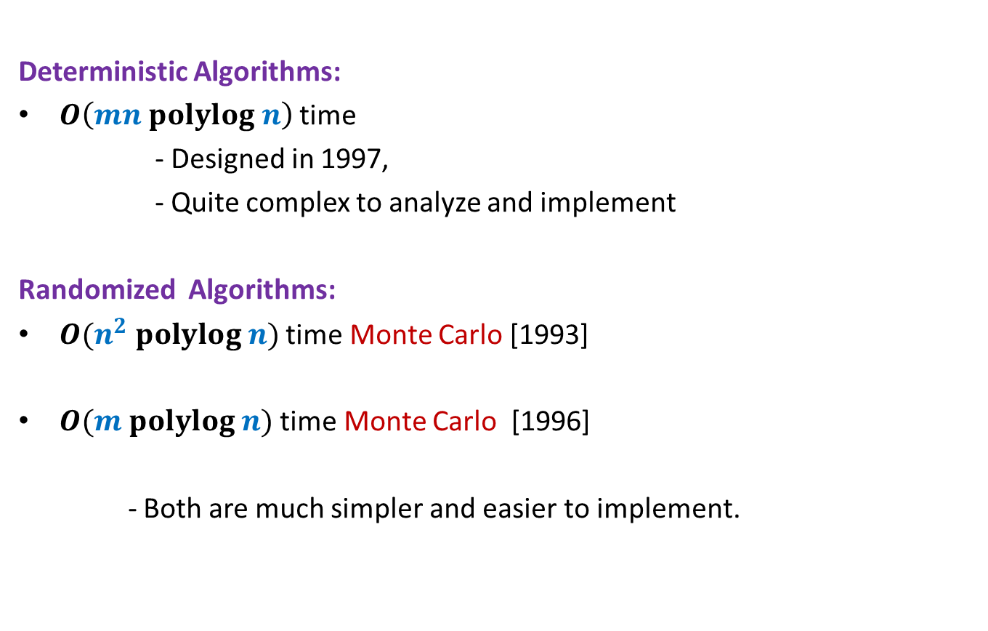
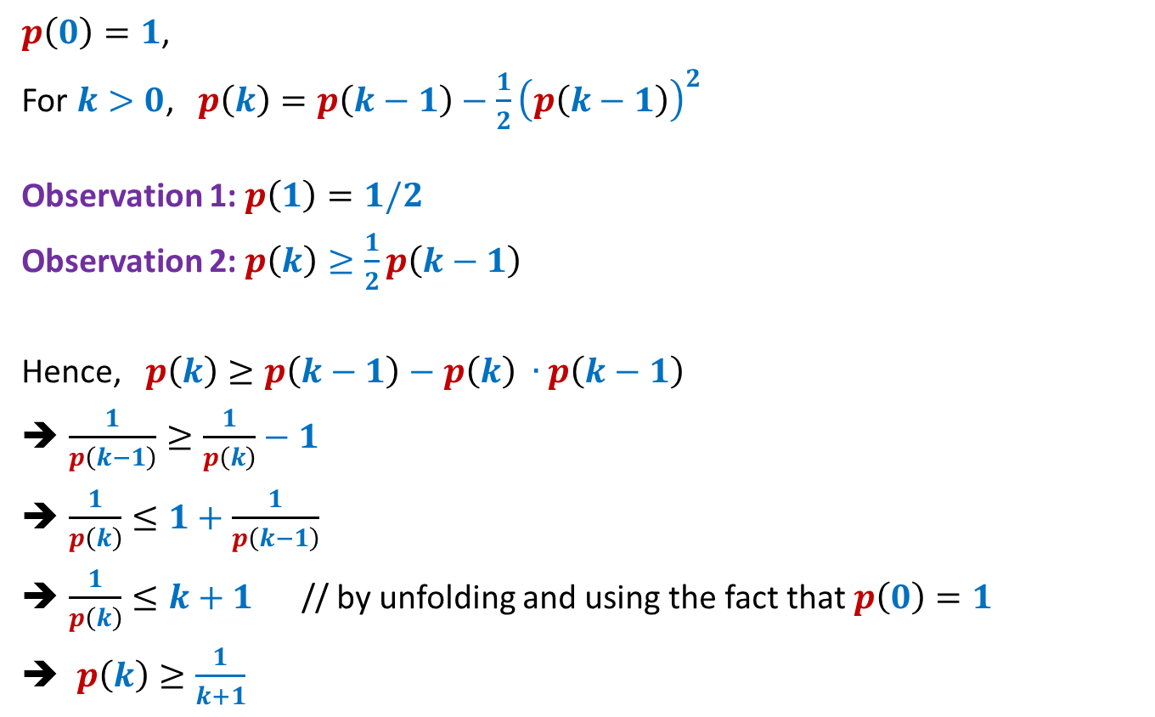
Solving the recurrence
$p\left(0\right)=1$,
For $k>0$, $p\left(k\right)=p\left(k−1\right)−\frac{1}{2}{\left(p\left(k−1\right)\right)}^{2}$
Observation 1: $p\left(1\right)=1/2$
Observation 2: $p\left(k\right)≥\frac{1}{2}p\left(k−1\right)$
Hence, $p\left(k\right)≥p\left(k−1\right)−p\left(k\right) ∙p\left(k−1\right)$
$\frac{1}{p\left(k−1\right)}≥\frac{1}{p\left(k\right)}−1$
$\frac{1}{p\left(k\right)}≤1+\frac{1}{p\left(k−1\right)}$
$\frac{1}{p\left(k\right)}≤k+1$ // by unfolding and using the fact that $p\left(0\right)=1$
$p\left(k\right)≥\frac{1}{k+1}$
proof
$p\left(k\right)=p\left(k−1\right)−\frac{1}{2}{\left(p\left(k−1\right)\right)}^{2}$
$≥p\left(k−1\right)−\frac{1}{2}p\left(k−1\right)$ //since $p\left(k−1\right)≤1$
$=\frac{1}{2}p\left(k−1\right)$

Slide 24


$p\left(k\right)≥\frac{1}{k+1}$
$p\left(k\right)$denotes $q\left({\left(\sqrt{2}\right)}^{k}\right)$.
$q\left(n\right) ≥\frac{1}{2 log n}$
Theorem:
There exists O($n^{2}$ $log^{3} n$) time Monte Carlo algorithm to min-cut
With success probability $≥1−\frac{1}{n^{4}}$
$$n$$

Slide 25
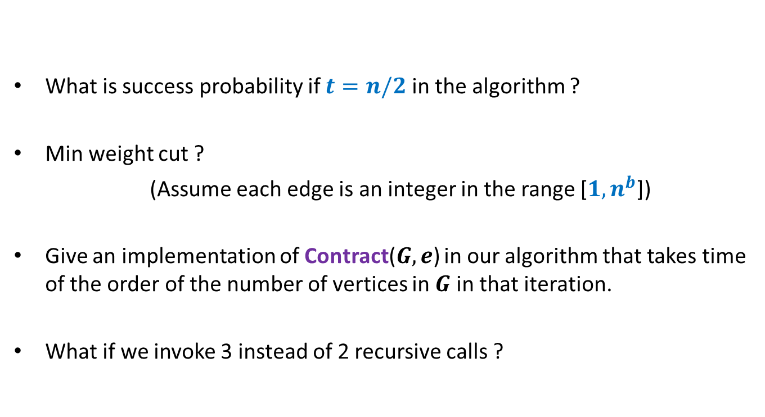
Homework
What is success probability if $t=n/2$ in the algorithm ?
Min weight cut ?
(Assume each edge is an integer in the range [$1,n^{b}$])
Give an implementation of Contract($G,e$) in our algorithm that takes time of the order of the number of vertices in $G$ in that iteration.
What if we invoke 3 instead of 2 recursive calls ?

Slide 26
Routing
Distributed
Packet has (source, destination)
Routing table

Slide 27
Dilation :
Congestion :
Queue management :
The maximum length of any path
The maximum number of packets that cross any edge
Policy of breaking ties

Slide 28

The only assumption for the queuing policy
If a packet in not allowed to traverse an edge in a round,
there is another packet which traverses the edge in that round.
$$P$$

Slide 29

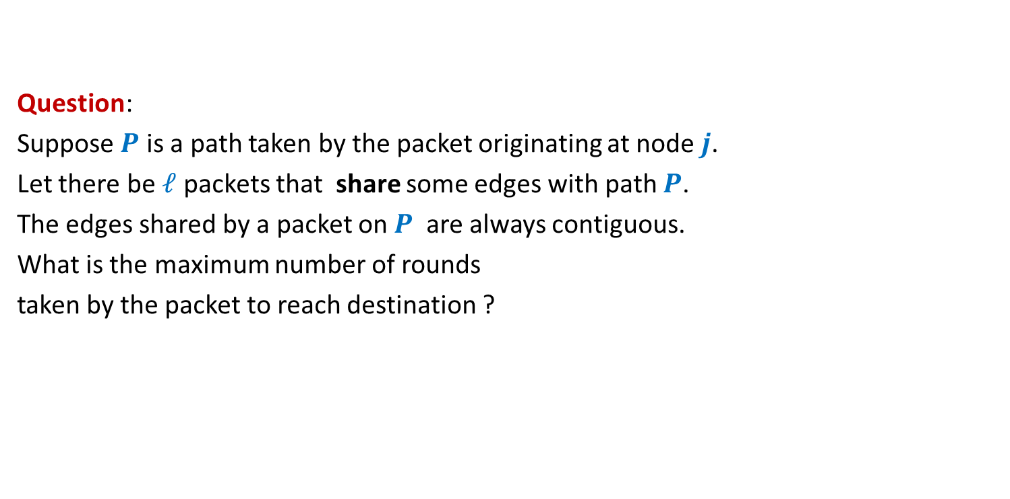
A warm-up question
Question:
Suppose $P$ is a path taken by the packet originating at node $j$.
Let there be $ℓ$ packets that share some edges with path $P$.
The edges shared by a packet on $P$ are always contiguous.
What is the maximum number of rounds
taken by the packet to reach destination ?
$$≤\left|P\right|⋅ℓ$$

Slide 30



source
$$j$$
$$P$$
destination

Slide 31
source
$$j$$
$$P$$
destination

Slide 32
source
$$j$$
$$P$$
destination

Slide 33
source
$$j$$
$$P$$
destination

Slide 34
source
$$j$$
$$P$$
destination

Slide 35
source
$$j$$
$$P$$
destination

Slide 36
source
$$j$$
$$P$$
destination

Slide 37
source
$$j$$
$$P$$
destination

Slide 38

source
$$j$$
Answer: $\left|P\right|+ℓ$
$$P$$
destination

Slide 39
Routing on Hypercube

Slide 40


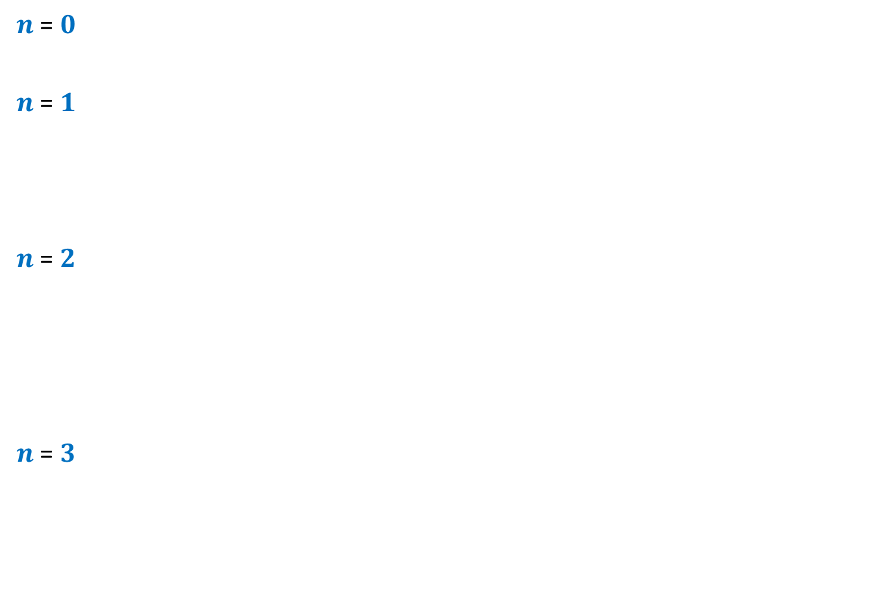













$n$-Hypercube
$n$ = $0$
$n$ = $1$
$n$ = $2$
$n$ = $3$
$$0$$
$$1$$
$$10$$
$$11$$
$$00$$
$$01$$
$$110$$
$$111$$
$$100$$
$$101$$
$$010$$
$$011$$
$$000$$
$$001$$

Slide 41



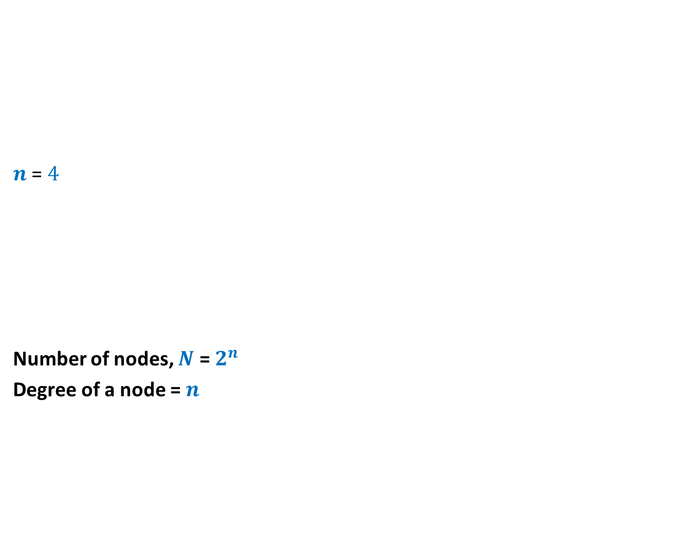













$n$-Hypercube
$n$ = $4$
Number of nodes, $N$ = $2^{n}$
Degree of a node = $n$
$$0110$$
$$0111$$
$$1110$$
$$1111$$
$$0100$$
$$0101$$
$$1100$$
$$1101$$
$$0010$$
$$0011$$
$$1010$$
$$1011$$
$$0000$$
$$0001$$
$$1000$$
$$1001$$

Slide 42
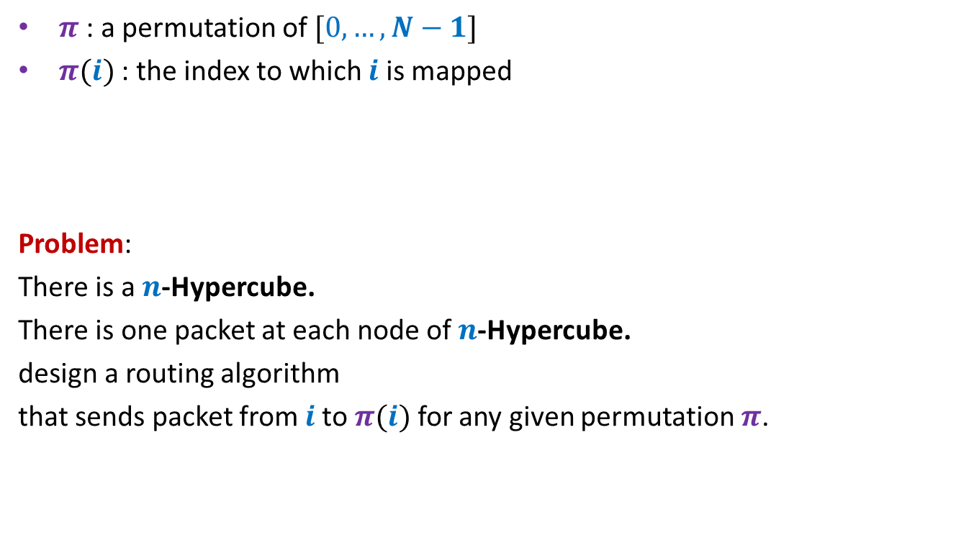

Permutation Routing on a $n$-Hypercube
$π$ : a permutation of $[0,…,N−1]$
$π(i)$ : the index to which $i$ is mapped
Problem:
There is a $n$-Hypercube.
There is one packet at each node of $n$-Hypercube.
design a routing algorithm
that sends packet from $i$to $π(i)$ for any given permutation $π$.

Slide 43

$n$-Hypercube
$n$ = $4$
$$0110$$
$$0111$$
$$1110$$
$$1111$$
$$0100$$
$$0101$$
$$1100$$
$$1101$$
$$0010$$
$$0011$$
$$1010$$
$$1011$$
destination
$$0000$$
$$0001$$
$$1000$$
$$1001$$
source

Slide 44
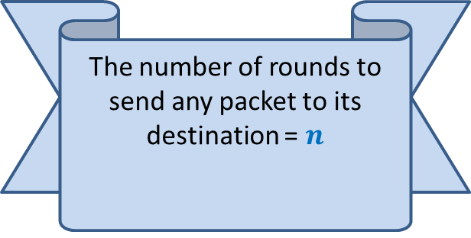
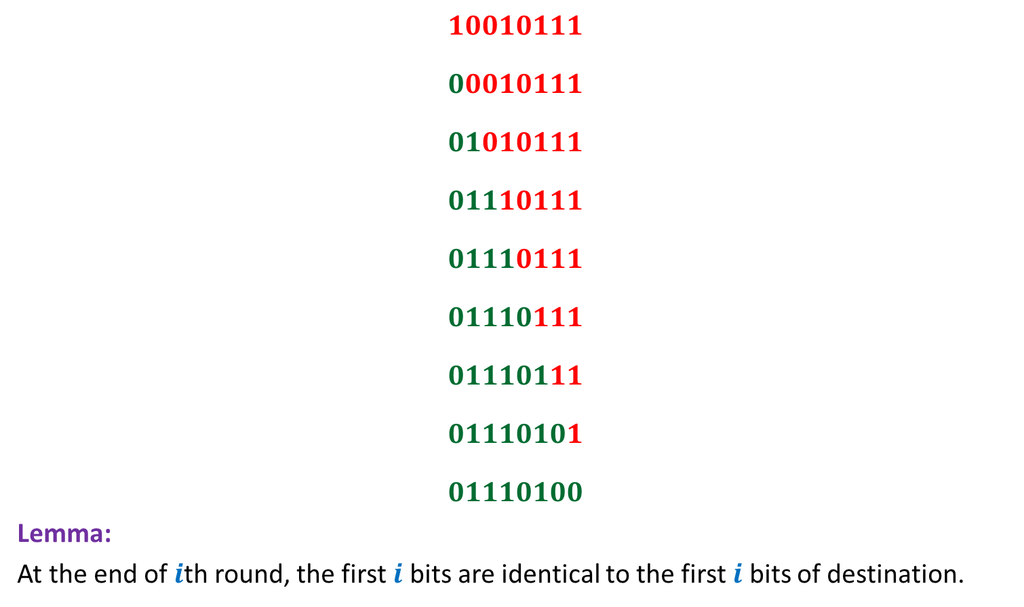
Bit-fixing algorithm
source
$$10010111$$
$$00010111$$
$$01010111$$
$$01110111$$
$$01110111$$
$$01110111$$
$$01110111$$
$$01110101$$
$$01110100$$
Lemma:
At the end of $i$th round, the first $i$ bits are identical to the first $i$ bits of destination.
The number of rounds to send any packet to its destination = $n$
No routing table needed
☺
(if there is no congestion
in the network)
destination

Slide 45
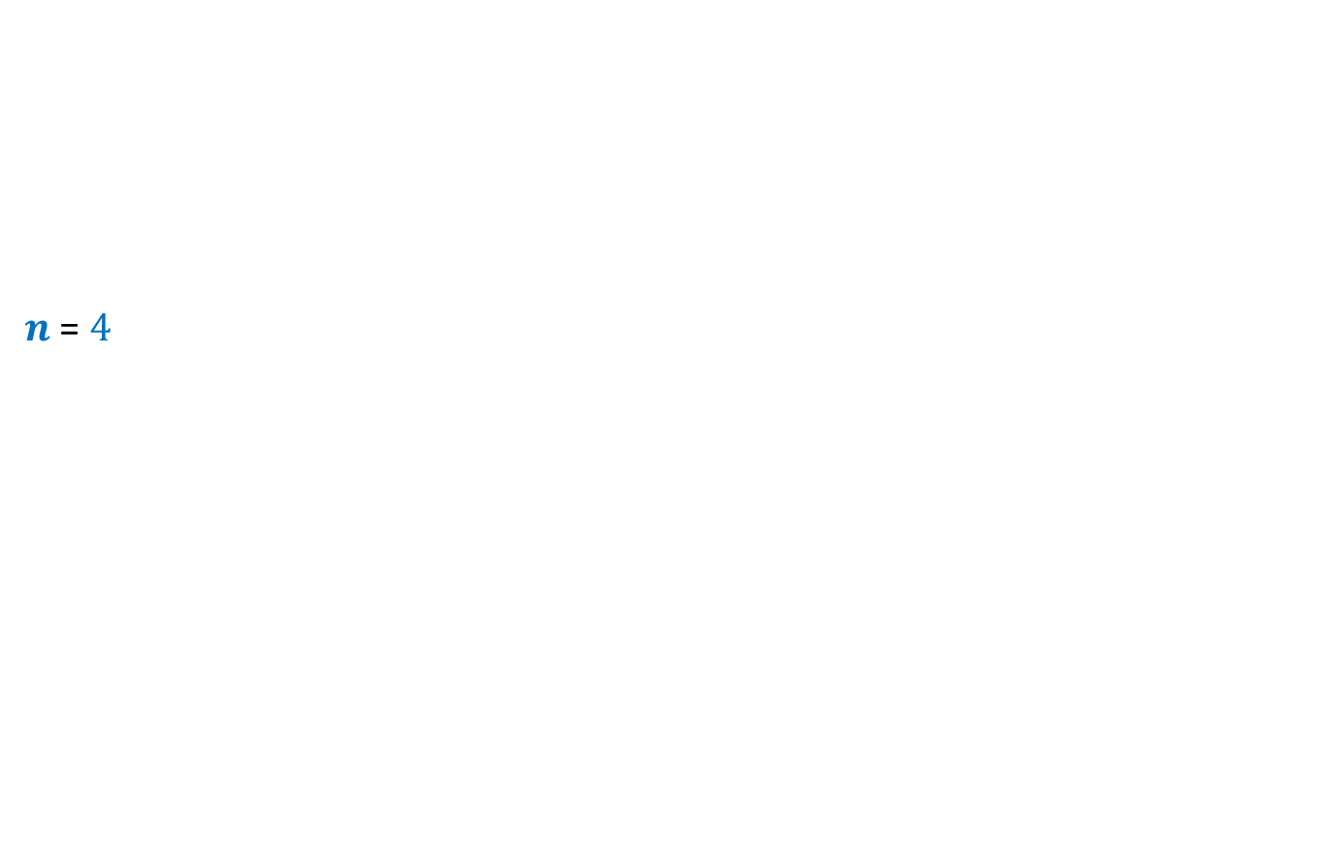
$n$-Hypercube
$n$ = $4$
$$0110$$
$$0111$$
$$1110$$
$$1111$$
$$0100$$
$$0101$$
$$1100$$
$$1101$$
$$0010$$
$$0011$$
$$1010$$
$$1011$$
destination
$$0000$$
$$0001$$
$$1000$$
$$1001$$
source

Slide 46







Worst case Permutation
source
$$a_{1},…{,a}_{\frac{n}{2}}$$
$$,b_{1},…{,b}_{\frac{n}{2}}$$
$$10010111$$
$$00010111$$
$$01010111$$
$$01110111$$
$$01110111$$
$$01111001$$
$$01111001$$
$$01111001$$
$$01111001$$
$N$ messages to pass through $\sqrt{N}$ nodes ➔At least $\frac{\sqrt{N}}{n}$ messages to pass through an edge
$$b_{1},…{,b}_{\frac{n}{2}}$$
$$, b_{1},…{,b}_{\frac{n}{2}}$$
$$b_{1},…{,b}_{\frac{n}{2}}$$
$$,a_{1},…{,a}_{\frac{n}{2}}$$
destination

Slide 47
How to use Randomization to avoid congestion?
Ponder over it as homework

